Slide 1
Introduction to the SharePoint Framework
Notes:
This module introduces students to the SharePoint Framework (SPFX) and the extensive API it provides for client-side development. Students will learn to create new SPFX projects using the Yeoman generator and to develop SPFX projects using Visual Studio Code. The module examines the different types of components that can be created with SPFX including Web Parts, Application Customizers, Field Customizers and Command Sets. Students will learn how to extend a Web Part with custom properties that can be viewed and edited by users in the Web Part Properties Pane. The module also teaches best practices for managing CSS styles in an SPFX project using SCSS files and CSS modules. Students will learn how to test and debug SPFX projects in the local SharePoint Workbench as well as in the hosted SharePoint Workbench running inside a test site in SharePoint Online.

Slide 2
Agenda
Introduction to the SharePoint Framework
Creating SPFX Projects using the Yeoman Generator
Testing & Debugging Webparts in SharePoint Workbench
Managing Styles using SCSS Files and CSS Modules
Creating a Web Part with Custom Properties
Creating Application Customizers

Slide 3
Evolution of the SharePoint Platform
Farm Solutions
Server-side DLLs and XML Definitions
Sandboxed Solutions
SharePoint Apps Add-ins
iFrames used to add in security dimension
complexity of 2 domains (app web vs host web)
JavaScript Injection
Scripting can be disabled
No formal deployment model
SharePoint Framework (SPFx)

Slide 4
What is SPFx?
Development model based on pages and web parts
Based on client-side development with JavaScript or TypeScript
Code runs with authenticated identity of current user
Easy access to SharePoint and Office 365 content and data
Developer tools designed to support cross-platform development
Great support for targeting mobile devices
SharePoint Page
Client-side Web Part 1
Client-side Web Part 2
TypeScript
TypeScript
Knockout
React
SharePoint REST API
Microsoft Graph API

Slide 5
How Does SPFx Work?
No more iFrames
Code runs the context of the current page
Code runs with identity and permissions of user
Uses open browser connections for current user
Supports lifecycle events
render, load, serialize, deserialize, etc.
Use whatever JavaScript framework you want
React, Handlebars, Knockout, Angular1, Angular2, D3

Slide 6
Cross-platform Toolchain
Node.js
Node Package Manager (npm)
TypeScript
Yeoman
Webpack
Gulp
git

Slide 7
Installing Packages for SPFx Development
Install Gulp
npm install -g gulp
Install Yeoman
npm install -g yo
Install Yeoman Template for SPFx
npm install -g @microsoft/generator-sharepoint

Slide 8
Agenda
Introduction to the SharePoint Framework
Creating SPFX Projects using the Yeoman Generator
Testing & Debugging Webparts in SharePoint Workbench
Managing Styles using SCSS Files and CSS Modules
Creating a Web Part with Custom Properties
Creating Application Customizers

Slide 9
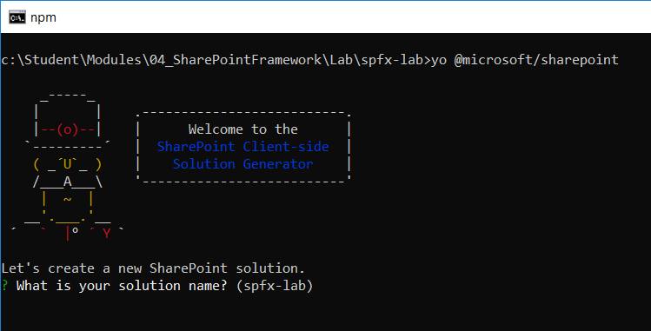
Using the SPFx Yeoman Template
SPFx projects created with Yeoman template
yo @microsoft/sharepoint

Slide 10
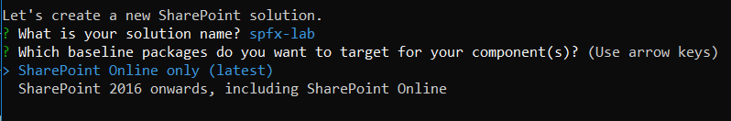
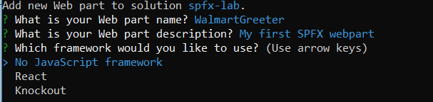
Answering Questions about a New Project
Do you want to support SharePoint On-premises?
Do you want to create a webpart or an SPFx extension
Do you want to create a standard webpart or a React webpart

Slide 11
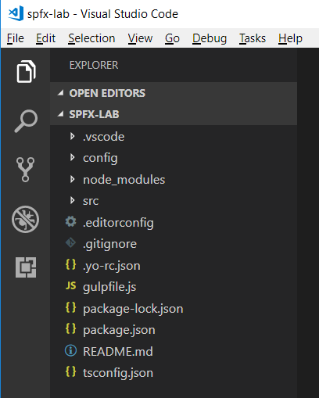
SharePoint Framework Project Structure
Project created as Node.js project

Slide 12
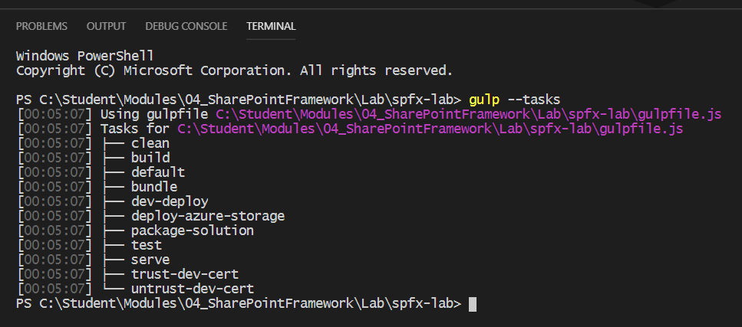
SharePoint Framework Adds Gulp Tasks
Run gulp --tasks to see SPFx gulp tasks added to project

Slide 13
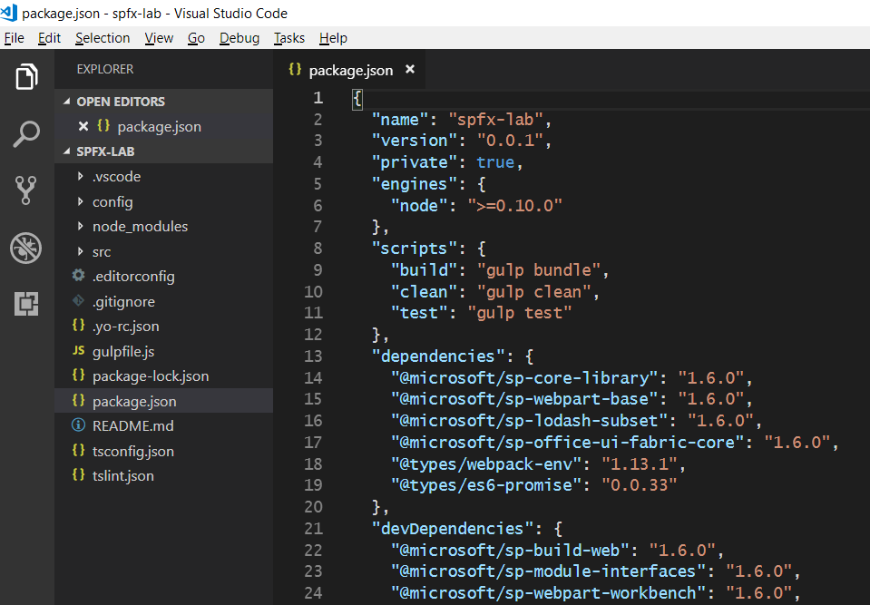
Package.json
SPFx API Version Number

Slide 14
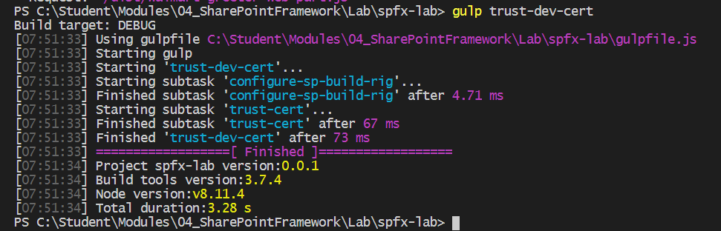
Running gulp trust-dev-cert
Testing SPFx code requires self-signed certificate
Certificate used serve pages with SSL at https://localhost
Certificated created and registered using gulp trust-dev-cert
gulp trust-dev-cert must be run within project directory
However, you only have to run this command once
No need to run gulp trust-dev-cert on a per-project basis

Slide 15
Agenda
Introduction to the SharePoint Framework
Creating SPFX Projects using the Yeoman Generator
Testing & Debugging Webparts in SharePoint Workbench
Managing Styles using SCSS Files and CSS Modules
Creating a Web Part with Custom Properties
Creating Application Customizers

Slide 16
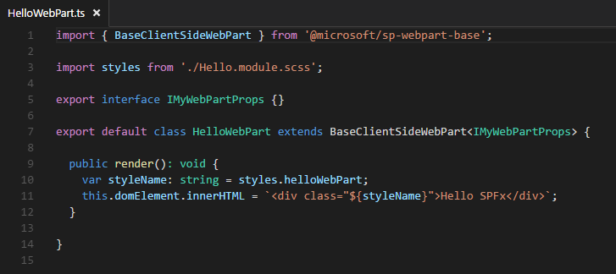
Developing a SPFx Web Part?
Create class that extends BaseClientSideWebPart
Override render() for minimal “hello world” functionality
Base class provides access to page context

Slide 17
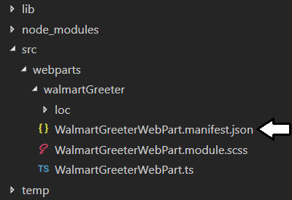
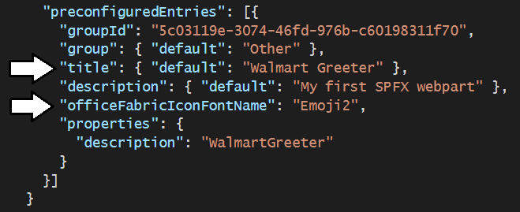
Webpart Manifest

Slide 18
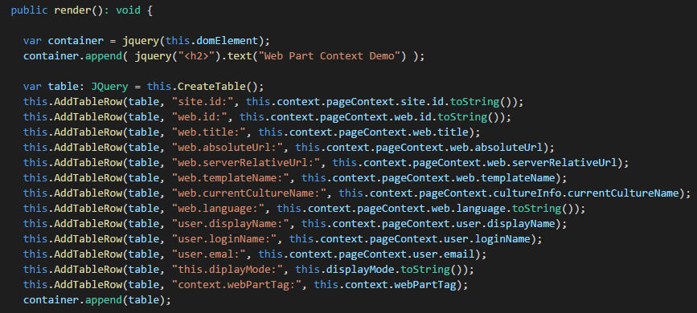
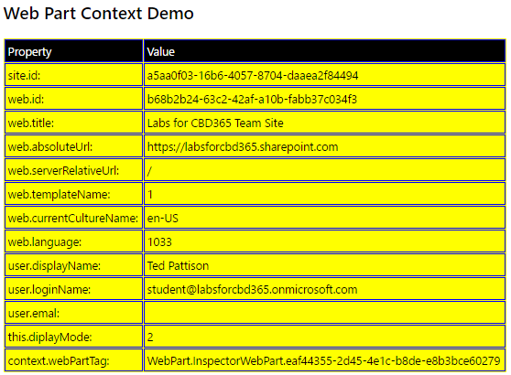
Web Part Context

Slide 19
Hello World with SPFx

Slide 20
Agenda
Introduction to the SharePoint Framework
Creating SPFX Projects using the Yeoman Generator
Testing & Debugging Webparts in SharePoint Workbench
Managing Styles using SCSS Files and CSS Modules
Creating a Web Part with Custom Properties
Creating Application Customizers

Slide 21
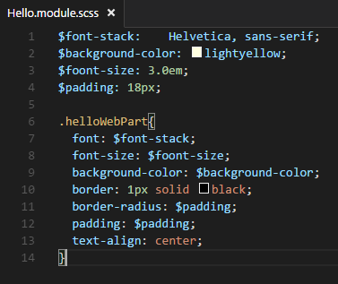
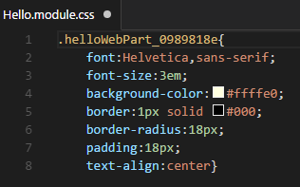
Working with SASS and .SCSS Files
Sass: Syntactically Awesome Style Sheets
Compiles .scss files into .css files
Allows build process to use variables and nesting
SASS

Slide 22
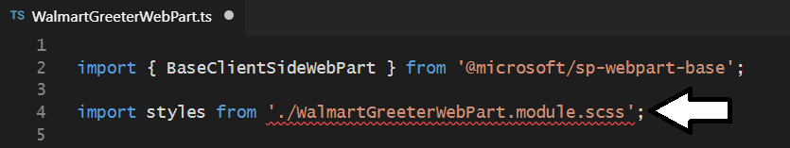
SCSS File Compilation

Slide 23
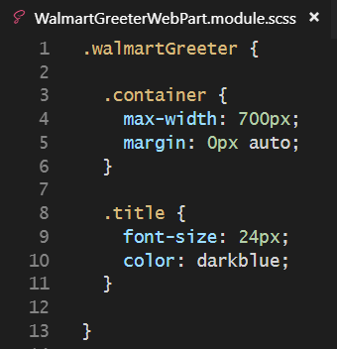
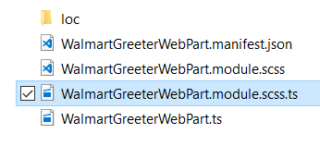
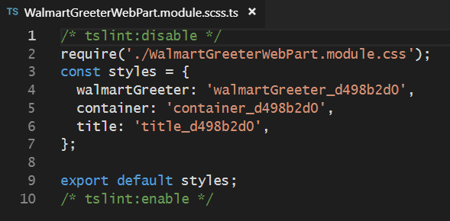
SCSS Module Compilation

Slide 24
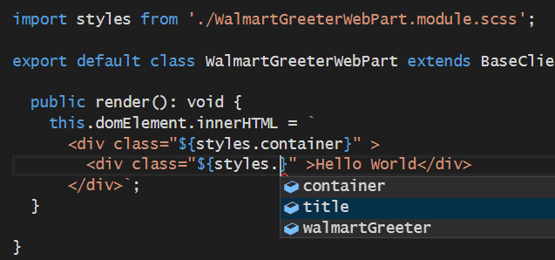

Slide 25
Agenda
Introduction to the SharePoint Framework
Creating SPFX Projects using the Yeoman Generator
Testing & Debugging Webparts in SharePoint Workbench
Managing Styles using SCSS Files and CSS Modules
Creating a Web Part with Custom Properties
Creating Application Customizers

Slide 26
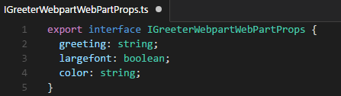
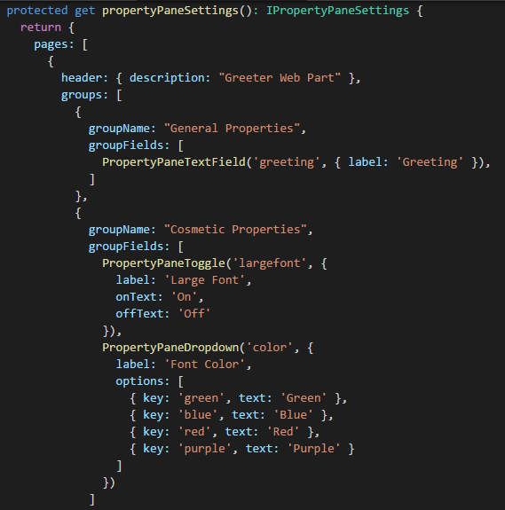
Web Part Properties
Define interface with properties
Add interface to web part class definition
Override panelPropertySettings()

Slide 27
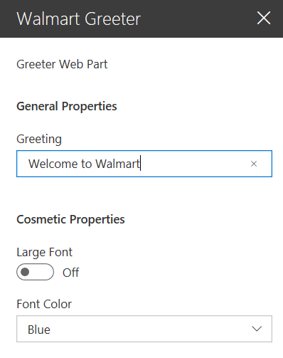
Property Panel Settings

Slide 28
Web Part Properties

Slide 29
Agenda
Introduction to the SharePoint Framework
Creating SPFX Projects using the Yeoman Generator
Testing & Debugging Webparts in SharePoint Workbench
Managing Styles using SCSS Files and CSS Modules
Creating a Web Part with Custom Properties
Creating Application Customizers

Slide 30
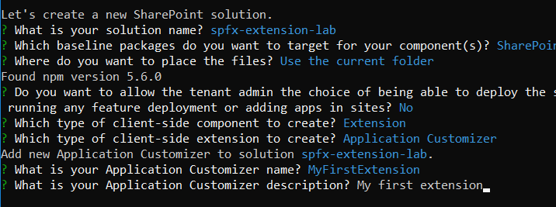
Creating an Application Customizer

Slide 31
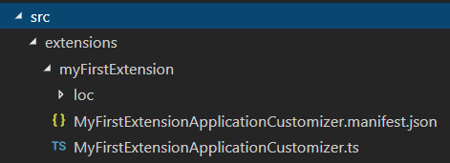

Slide 32
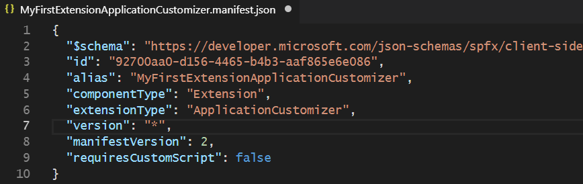
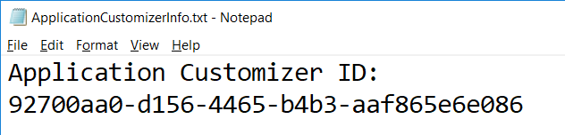

Slide 33
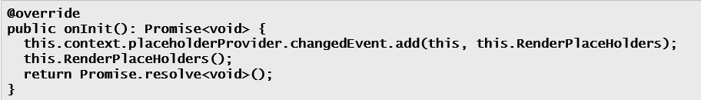
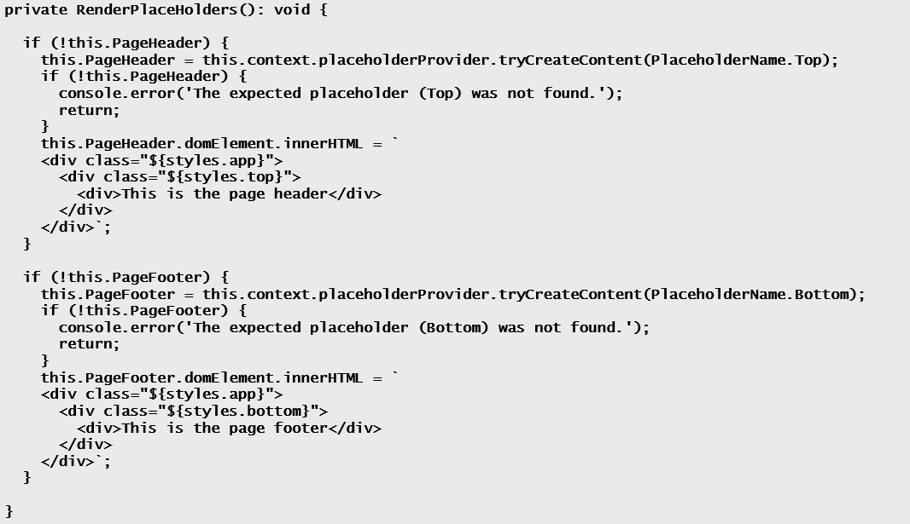

Slide 34
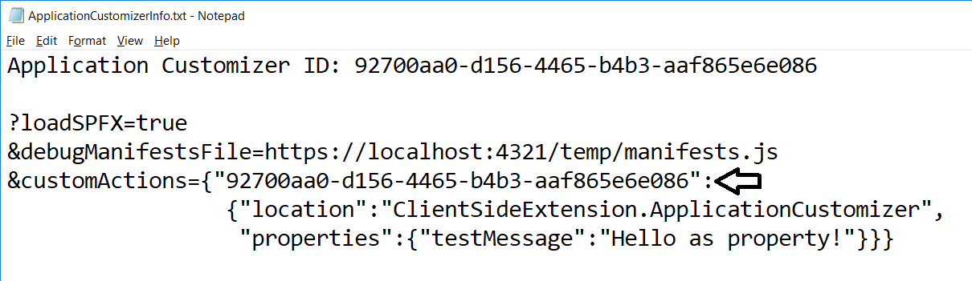

Slide 35
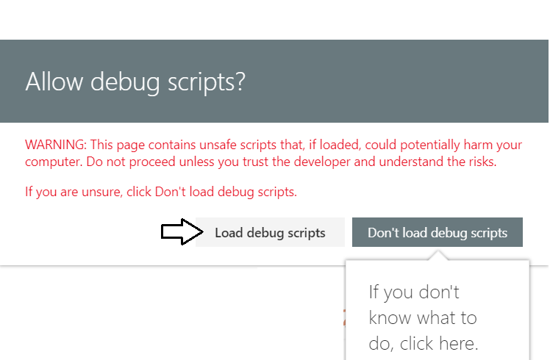
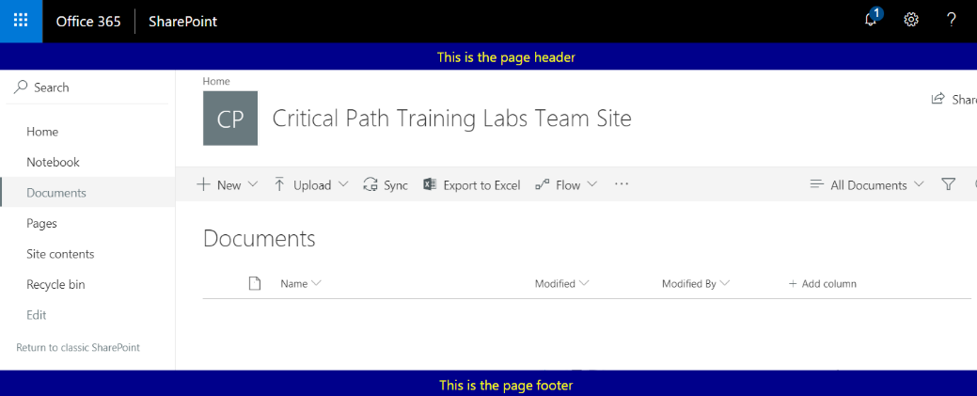

Slide 36
Summary
Introduction to the SharePoint Framework
Creating SPFX Projects using the Yeoman Generator
Testing & Debugging Webparts in SharePoint Workbench
Managing Styles using SCSS Files and CSS Modules
Creating a Web Part with Custom Properties
Creating Application Customizers

